Slide 1

Customer Retention Analysis – Canada Vapes
Group 5:
Neel Manishbhai Mendapara - 1275495
Nischith Sudarshan Reddy - 1258755
Parth Mihirbhai Patel - 1292923
Philip Maliki Amedu - 1238583
Pooja Somashekar - 1258760
Notes:
Good morning everyone.
Today, we are presenting our capstone project on Customer Retention Analysis for Canada Vapes.
In this project, our analysis focuses on understanding customer behavior after their first purchase.
Our goal is to identify key factors that influence whether customers return or churn, and to provide data-driven recommendations to improve retention.
To begin with, let’s understand the business context and the challenges faced by the company.

Slide 2

Business Context & Challenge
Company Overview
E-commerce retailer specializing in vaping products
Operates across Canada with growing customer base
Strong monthly customer acquisition (500–700 new customers)
Business Challenge
High acquisition but low customer retention
Many customers do not return after first purchase
Current: ~3,500 returning customers
Target: Increase to 5,000 returning customers
Notes:
Canada Vapes is an e-commerce retailer specializing in vaping products across Canada. The company has been successful in acquiring new customers, with approximately 500 to 700 new customers each month.
However, the main challenge lies in customer retention. Despite strong acquisition, a large number of customers do not return after their first purchase. Currently, the company has around 3,500 returning customers, with a target to increase this number to 5,000.
This raises an important business question — what factors influence whether a customer returns or churns after their first purchase?

Slide 3
Project Objective
Analyze customer behavior after first purchase
Identify early indicators of retention and churn
Examine key factors: order value, items purchased, product selection
Develop data-driven strategies to improve retention
Support business goal of increasing returning customers
Notes:
To address this challenge, our objective was to analyze customer behavior immediately after the first purchase, as this stage plays a critical role in determining long-term engagement.
We focused on identifying early indicators of retention and churn, particularly factors such as order value, number of items purchased, and product selection.
Based on these insights, we aimed to develop data-driven strategies that can help increase customer retention and support the company’s goal of reaching 5,000 returning customers.

Slide 4
Data & Analytical Approach
Customer dataset: total orders, spending, average order value, location
Transaction dataset: purchase date, products, items sold, net sales
Data preparation: cleaning, handling missing values, merging datasets
Created Customer_ID for consistent tracking
Applied exploratory and behavioral analysis techniques
Notes:
To achieve our objective, we used two main datasets: a customer dataset and a transaction dataset.
The customer dataset provided information such as total orders, total spending, and average order value, while the transaction dataset gave us detailed insights into what customers purchased and when.
We performed data cleaning and preprocessing, including handling missing values and merging the datasets using a unique Customer_ID.
After preparing the data, we applied exploratory and behavioral analysis techniques to identify patterns that influence customer retention.

Slide 5
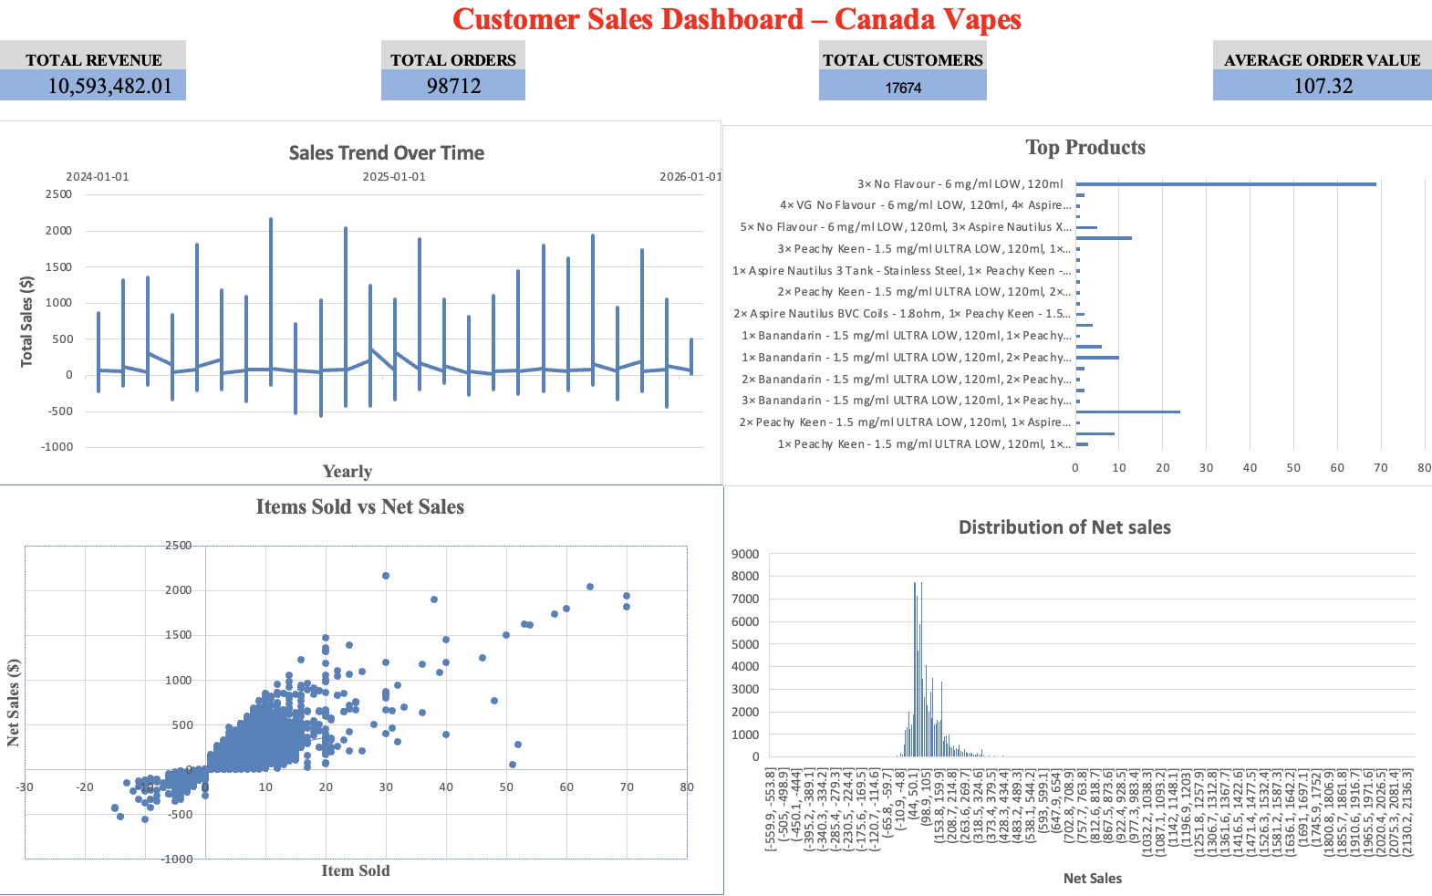
Key Performance Overview
Total Revenue: Overall business performance
Total Orders: Customer activity level
Total Customers: Customer base size
Average Order Value (AOV): Spending behavior
Notes:
Before diving into detailed analysis, we first looked at the overall business performance using key performance indicators.
These metrics help us understand the scale of operations and customer activity.
Total revenue gives an overview of business performance, while total orders and customers indicate engagement levels.
One of the most important metrics here is average order value, as it reflects how much customers are spending per transaction and plays a key role in understanding customer behavior.

Slide 6
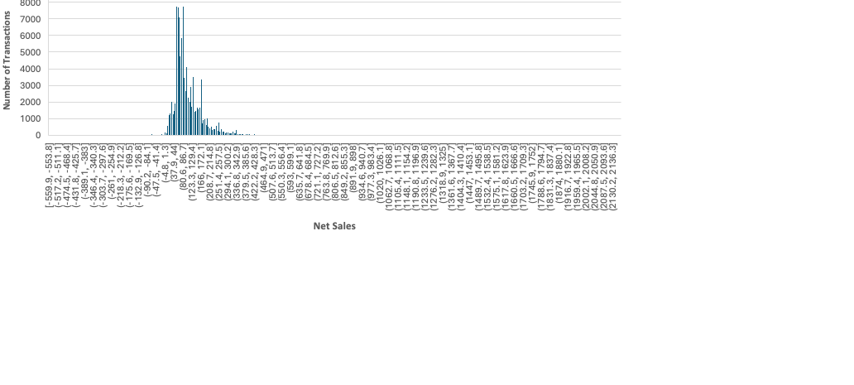
Sales Distribution
Majority of transactions are low to moderate value
Few high-value transactions contribute significantly
Indicates uneven revenue distribution
Notes:
This chart shows the distribution of net sales across transactions.
We can observe that most transactions fall within a lower to moderate value range, while only a small number of transactions are significantly higher in value.
This indicates that revenue is highly skewed, where a small group of transactions contributes a large portion of total revenue.
From a business perspective, this suggests an opportunity to increase overall revenue by encouraging customers to move from low-value to higher-value purchases.

Slide 7
Yearly Sales Trend
Sales fluctuate across months
Indicates changing customer demand
Possible impact of promotions or seasonality
Opportunity to optimize marketing timing
Notes:
This chart shows how sales change over time.
We can observe that sales fluctuate across different months, indicating that customer demand is not consistent.
These variations may be influenced by factors such as promotions, seasonal demand, or external market conditions.
From a business perspective, this suggests that aligning marketing strategies with high-demand periods can help improve overall performance.
While this helps us understand when customers purchase, the next step is to understand how they purchase.

Slide 8
Items Sold vs Net Sales
Strong positive relationship observed
More items → higher transaction value
Indicates higher engagement level
Key driver of revenue and retention
Notes:
This is one of the most important insights from our analysis.
The scatter plot clearly shows a strong positive relationship between the number of items purchased and total sales.
In simple terms, customers who buy more items generate higher revenue.
More importantly, this also reflects stronger engagement, as customers purchasing multiple items are more involved with the product range.
This makes basket size a key factor influencing both revenue and potential customer retention.
Now that we understand how purchase quantity impacts revenue, let’s look at what customers are actually buying.

Slide 9
Top Products Purchased
Demand concentrated among few products
Not evenly distributed across catalog
High-performing products drive engagement
Opportunity for targeted promotions
Notes:
This chart shows that customer demand is concentrated among a limited number of products.
Instead of evenly distributed demand, a few products appear significantly more frequently than others.
This indicates strong customer preferences and highlights key products that drive engagement.
From a business perspective, these products can be strategically used for promotions, cross-selling, and improving customer retention.
Based on these analyses, we can now summarize the key insights that explain customer behavior.

Slide 10
Key Insights
Higher AOV → stronger engagement
Multi-item purchases → higher revenue
Revenue concentrated among fewer customers
Demand focused on key products
Early engagement is critical
Notes:
From our analysis, we identified several key insights.
First, higher order value is associated with stronger customer engagement.
Second, customers who purchase multiple items generate higher revenue and show deeper interaction with the product range.
Third, revenue is concentrated among a smaller group of customers, indicating the importance of high-value transactions.
Finally, customer engagement is highly time-sensitive, making early interaction after the first purchase critical for retention.

Slide 11

Recommendations
Introduce product bundling strategies
Implement early post-purchase engagement (7–14 days)
Promote high-performing products
Offer incentives to increase order value
Target high-value customers
Notes:
Based on our findings, we developed several key recommendations.
First, introducing product bundling can encourage customers to purchase multiple items, increasing both order value and engagement.
Second, implementing early follow-up strategies within 7 to 14 days after the first purchase can significantly improve retention, as this is a critical engagement window.
Third, high-performing products should be promoted strategically, as they already drive customer interest and can be used for cross-selling.
In addition, offering incentives such as discounts or free shipping can encourage customers to increase their basket size.
Finally, identifying and targeting high-value customers early can help maximize retention and improve overall business performance.
Now let’s look at how these recommendations translate into business impact.

Slide 12
Expected Business Impact
Increase repeat purchase rate
Improve customer engagement
Higher average order value
Stronger customer retention
Achieve 5,000 returning customers
Notes:
These recommendations are directly aligned with the identified behavioral patterns.
By increasing order value, encouraging multi-item purchases, and engaging customers early, the company can significantly improve customer retention.
As a result, Canada Vapes can move toward its goal of increasing the number of returning customers to 5,000.

Slide 13
Conclusion
Retention is Predictable, Not Random
First Purchase is Critical
Customer Behavior Drives Outcomes
Data-driven Strategies Improve Performance
Notes:
In conclusion, our analysis shows that customer retention is not random but driven by early purchasing behavior.
The first purchase plays a critical role in determining long-term engagement, and factors such as order value and number of items purchased are key indicators of retention.
By applying data-driven strategies, Canada Vapes can significantly improve customer retention and achieve its business goals.

